Slide 1
BLP CARTOONS
These cartoons are the sole property of BEST-AC and have been posted to for the purposes of sharing the Barriers to Business Launch event outcomes with our partners. The cartoonists that contributed to the cartoon contest won various prizes for these cartoons

Slide 2
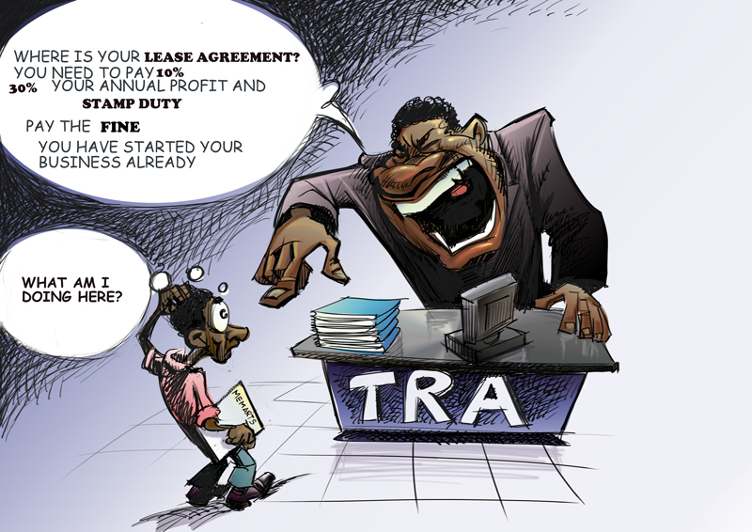

Slide 3
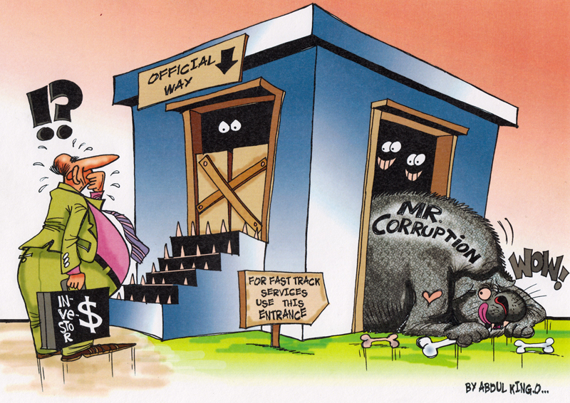

Slide 4
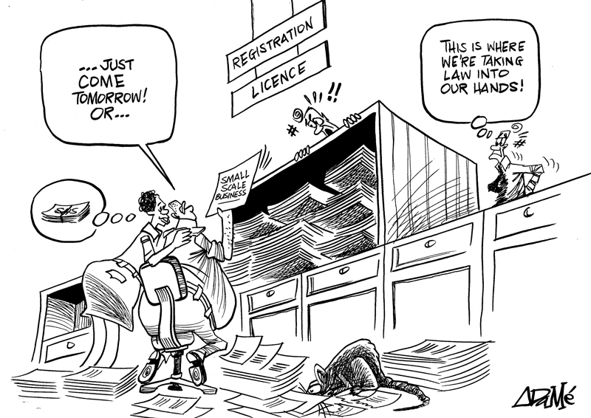

Slide 5
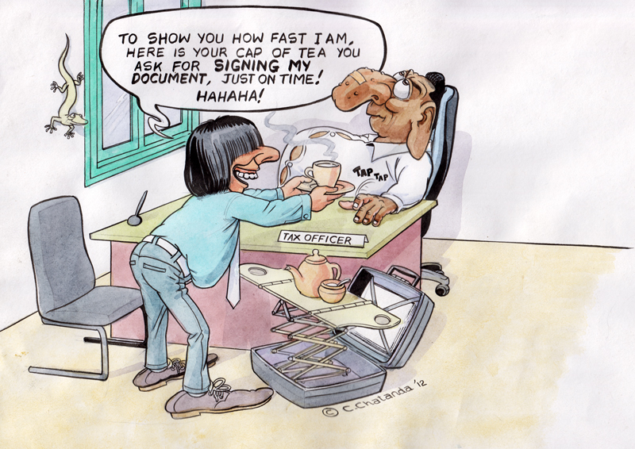

Slide 6
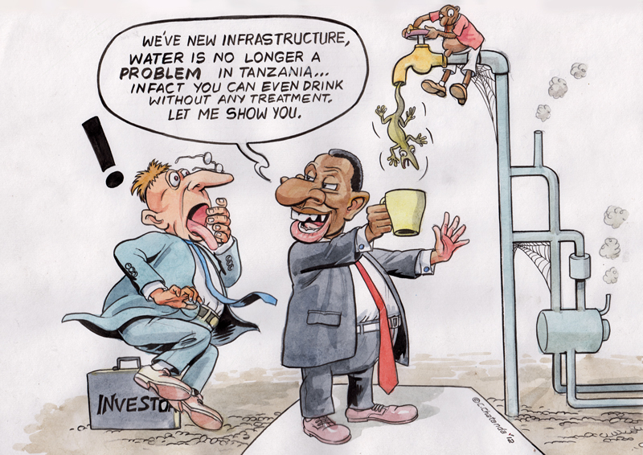

Slide 7
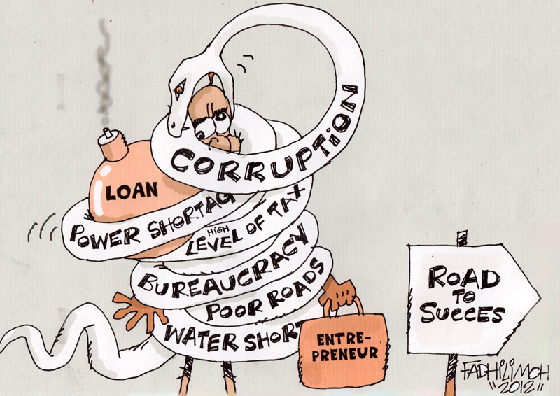

Slide 8
